Slide 1
Chisel3 presentation
Su-Wei Yang
Software verification
2023 spring

Slide 2
Outline
Architecture introduction
Installation
Verification
Ring counter

Slide 3
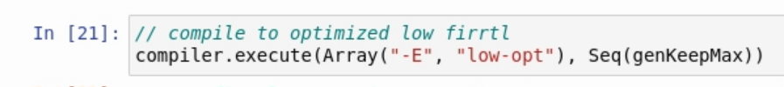
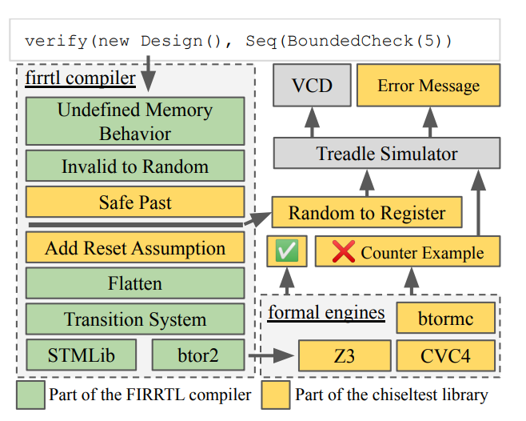
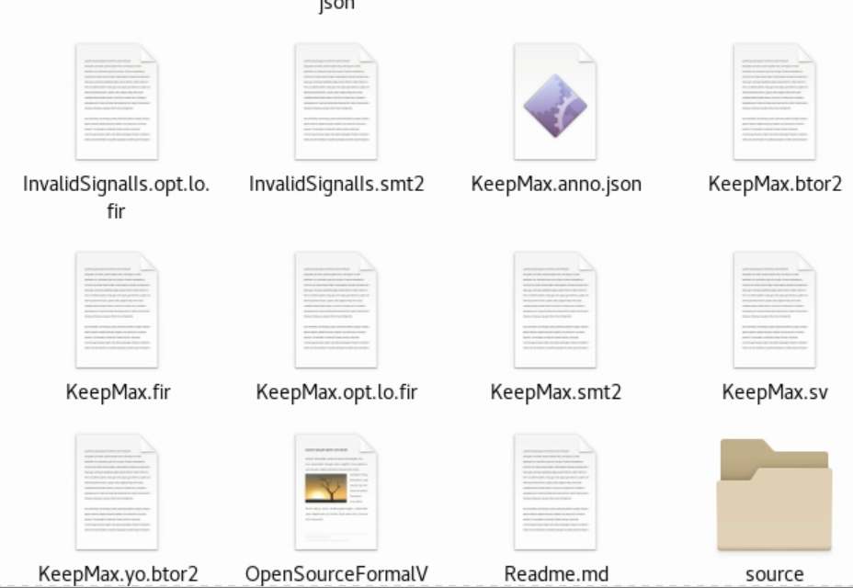
Architecture introduction
sv : system verilog file
fir & opt.lo.fir : fir compiler output
btor2 & smt2 : firrtl compiler output

Slide 4
Installation
Clone the notebook from: https://github.com/ekiwi/open-source-formal-verification-for-chisel
$ git clone https://github.com/ekiwi/open-source-formal-verification-for-chisel.git
Install scala kernel: https://almond.sh/docs/quick-start-install
$ curl -Lo coursier https://git.io/coursier-cli
$ chmod +x coursier
$ ./coursier launch --fork almond -- --install
$ rm -f coursier
$ ./coursier launch --fork almond:0.10.0 --scala 2.12.11 -- --install
View scala kernel in jupyter notebook by typing "jupyter kernelspec list" terminal.
$ jupyter kernelspec list
Find introduction: https://woset-worksho
Check out the introduction video and blog here

Slide 5
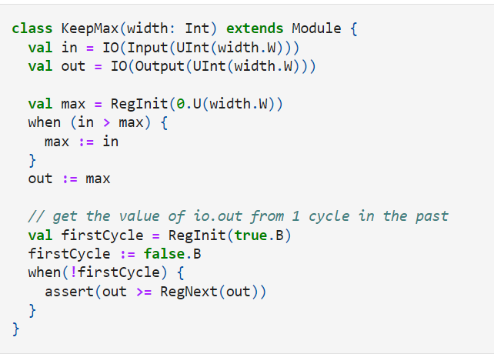
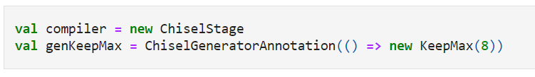

Verification
Build model (class)
Build compiler
Put model into compiler

Slide 6
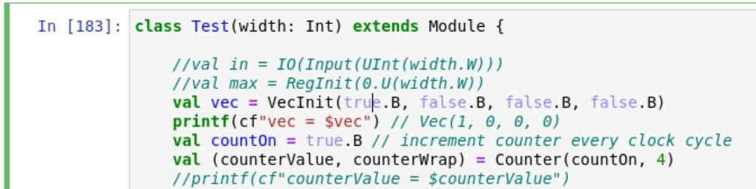
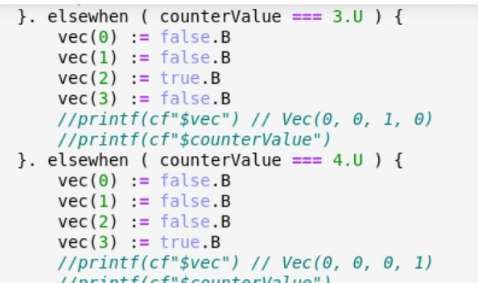
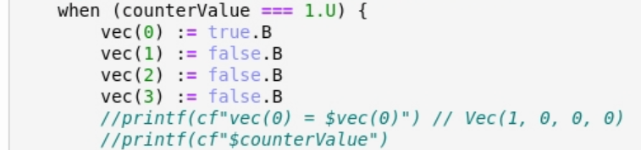
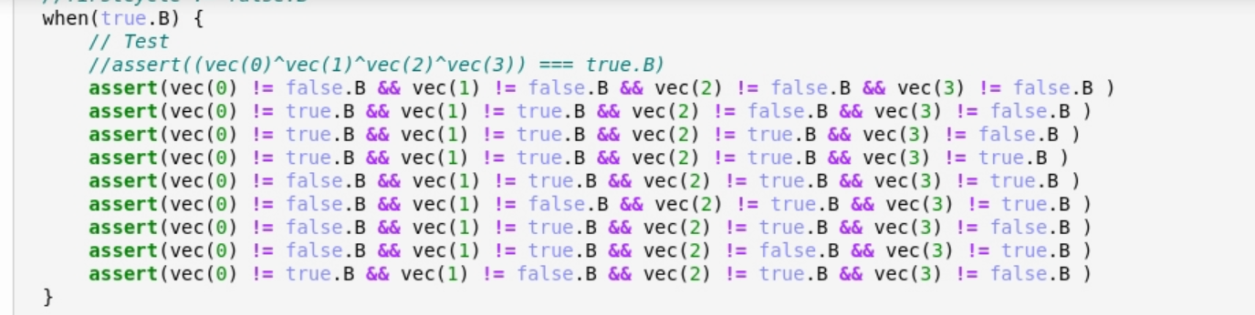
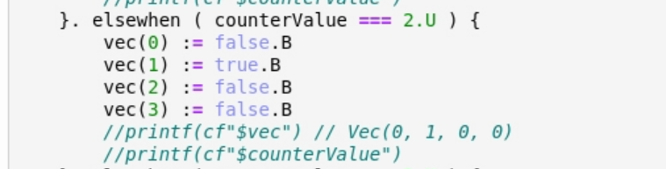
Ring counter

Slide 7
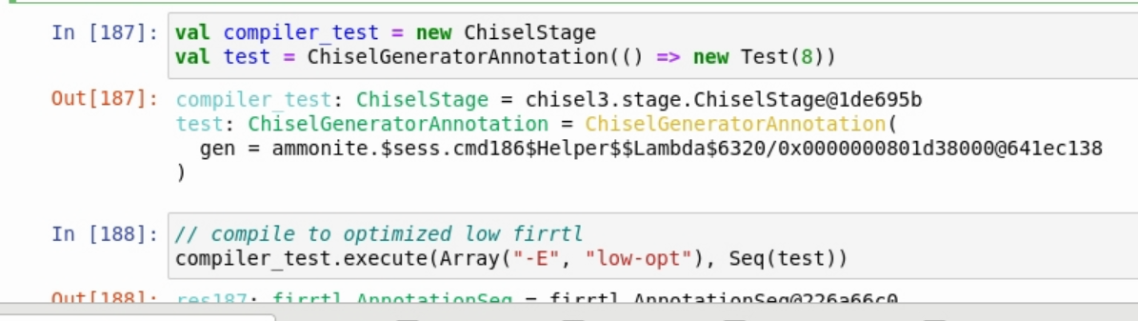
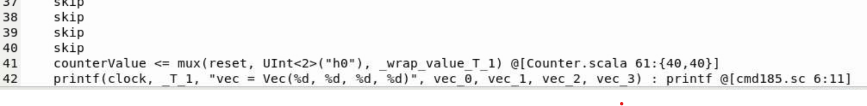
Ring counter

